Slide 1



Safe Steer Assistant
Jaypee University of Information Technology
Department of Computer Science and Engineering and Information Technology
Major Project - II (18B19CI891) | AY 2024-25
End-Term Evaluation | May 16-17, 2025.
Group No.: 44
Team Member (s)
Ansh Kumar (211314)
Skand Dev Dixit (211509)
Supervisor:
Name: Dr. Nancy Singla
Department: Computer Science & Engineering / Information Technology

Slide 2
Outline
Introduction
Problem Statement
Objectives
Work Done (after Mid-Term Evaluation)
Project Design
Implementation
Experimental Results and Evaluation
Key Learnings
Future Work
Work Contribution and Attendance
Supervisor Interactions
References

Slide 3
Introduction
Every day, drivers face risks due to drowsiness, distraction, or loss of focus on the road.
Driver fatigue contributes to up to 20% of all crashes worldwide.
The rise of mobile technology introduces new distractions that are dangerous when used while driving.
Traditional methods (e.g., rest breaks, lane-crossing alarms) often fail to keep the driver’s attention continuously.
A proactive, intelligent solution is needed to detect driver disengagement and provide timely intervention.

Slide 4
Problem Statement
Many current safety systems react only after dangerous situations have started, not before.
Drowsiness, distractions (like smartphone use), and loss of focus are leading causes of accidents.
There is a need for a system that:
Detects early signs of inattention.
Uses facial recognition and eye-tracking technology to monitor the driver’s real-time condition.
Issues tailored audible warnings to re-engage the driver when hazardous behaviors are detected (e.g., eyes closing, glancing away, smartphone usage).
The goal of the "Safe Steer Assistant" is to reduce accidents by fostering safer driving habits and reminding drivers to stay alert.

Slide 5
Objectives
Comprehensive Study of Existing Literature on Driver Drowsiness and Distraction
Development of Real-Time ML/DL-Based Models for Driver Drowsiness and Distraction Detection
To generate immediate audible alert on drowsiness and distraction detected by the developed ML/DL based model.
Promoting Safer Driving Practices through Technology and Awareness

Slide 6
Work Done (after Mid-Term Evaluation)
Change the dataset for Distraction Detection.
Change simple CNN model to MobileNetV2.
Training the model.
Develop the Real-Time Monitoring System using the saved model.

Slide 7
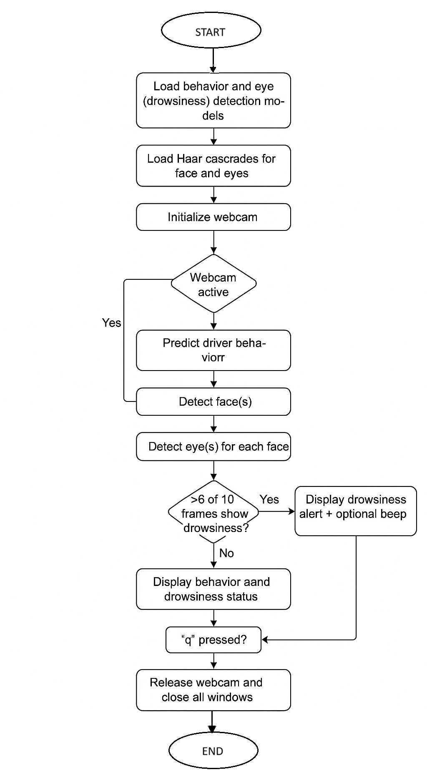
Project Design

Slide 8
Project Design (cont…)
Model Initialization
Loads pre-trained behavior and eye detection models for driver drowsiness monitoring.
Haar Cascade Load
Loads Haar cascade classifiers for face and eye detection using OpenCV.
Webcam Setup
Initializes the webcam to start real-time frame capture for processing.
Webcam Status Check
Continuously checks if the webcam is active before analyzing frames.
Behavior Prediction
Uses the loaded model to predict the driver's behavior from the frame.
Face Detection
Detects face(s) in the video frame using Haar cascades.

Slide 9
Project Design (cont…)
Eye Detection
For each detected face, identifies eyes and monitors their state (open/closed).
Frame Buffer Analysis
Monitors the last 10 frames; if 6 or more show drowsiness, flags the driver.
Alert System
Displays a visual alert and optionally triggers an audio beep for the driver.
Exit Condition & Cleanup
If ‘q’ is pressed, the system releases the webcam and closes all windows

Slide 10
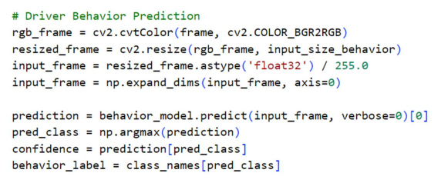
Implementation
Use MRL Eye dataset for Drowsiness detection model
Dataset contains eyes images.
 | Open Eyes | Close Eyes
Train | 16382 | 16383
Test | 3000 | 3000
Figure: Driver Behaviour Prediction

Slide 11
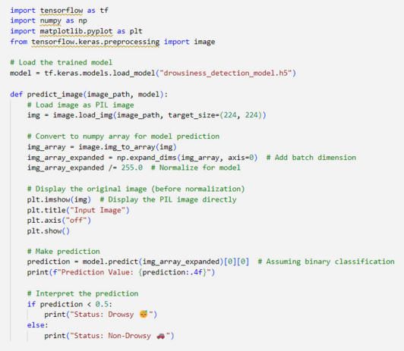
Implementation (cont…)
Figure: Prediction from the Drowsiness Model

Slide 12
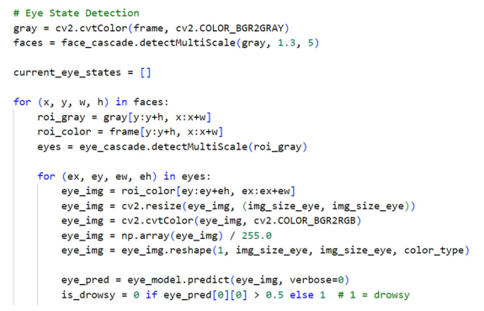
Implementation (cont…)
Figure: Eye State Detection

Slide 13
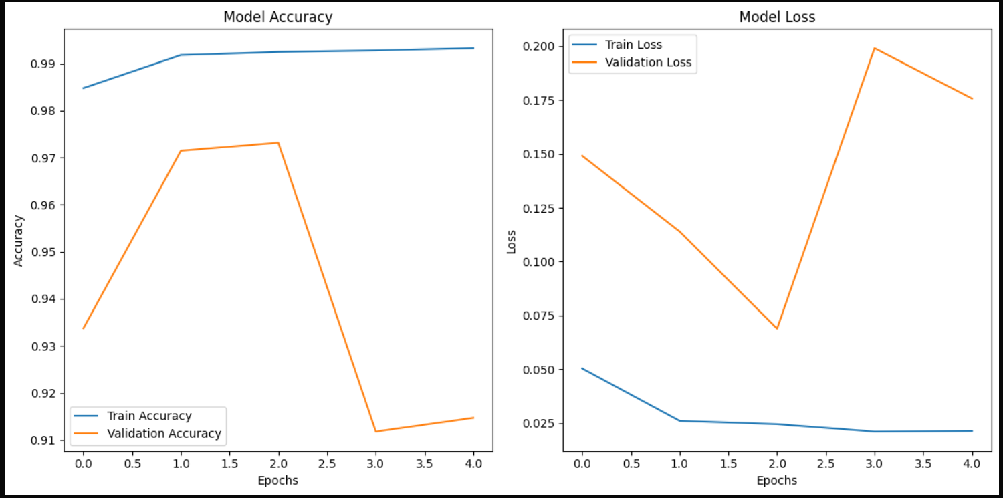
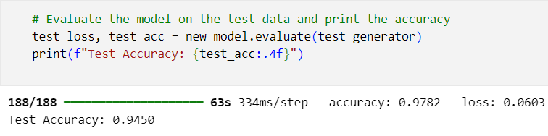
Experimental Results and Evaluation
Figure: Training and validation loss and accuracy plot over all epochs for drowsiness detection model
Figure: Test Accuracy of Drowsiness Detection Model: 94.5%

Slide 14
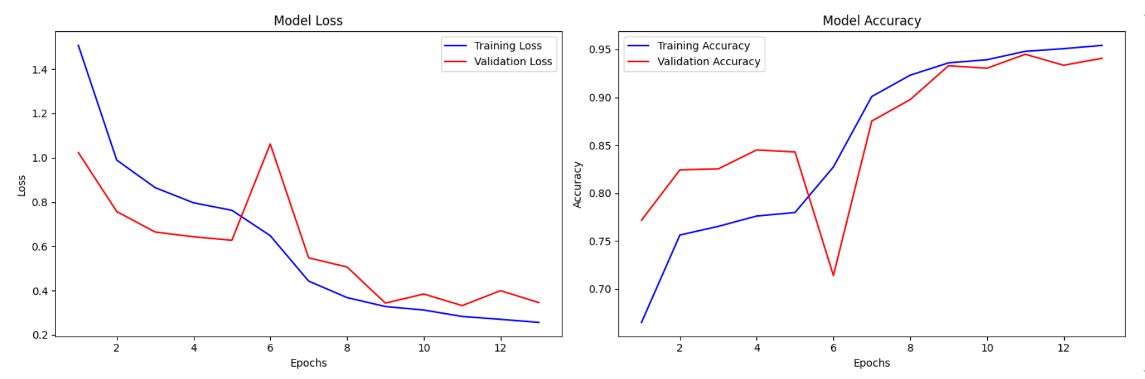
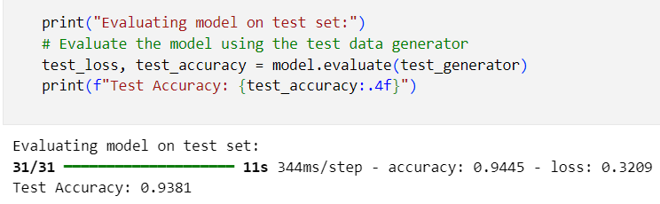
Experimental Results and Evaluation (cont…)
Figure: Training and validation loss and accuracy plot over all epochs for distraction detection model
Figure: Test Accuracy of Distraction Detection Model: 93.81%

Slide 15
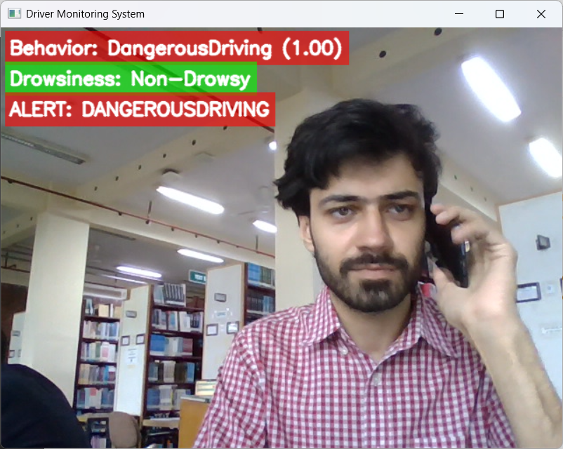
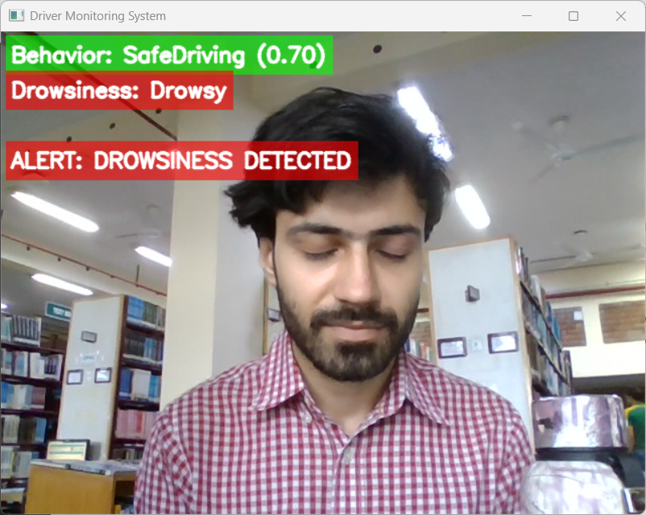
Experimental Results and Evaluation (cont…)
Figure: Test sample of real-time monitoring system

Slide 16
Key Learnings
Implemented real-time driver monitoring using computer vision and deep learning.
Designed and fine-tuned CNN architectures (MobileNet, MobileNetV2) for binary and multi-class classification tasks.
Applied transfer learning, data augmentation, and model optimization (callbacks, regularization).
Built a full real-time inference pipeline using OpenCV, Haar cascades, and concurrent model execution.
Integrated audio-visual alert mechanisms based on prediction confidence and severity of behavior.

Slide 17
Future Work
Integration with Advanced Vehicle Systems
Multimodal Monitoring
Personalized AI Models
Cloud Integration & Data Analytics
Mobile & Embedded Deployment

Slide 18
Work Contribution and Attendance
GitHub Repository URL: https://github.com/skand-dixit/Safe-Steer-Assistant
Team Member | Roll No. | Work Done (provide complete details) | Work Contribution (%) | Lines of Code (LoC) | Lab Attendance (%)
1. | 211509 | Collected dataset for drowsiness. Train the Drowsiness Detection Model Integrate both the models for Real-time Monitoring Prepare Project Report Managed GitHub repository | 50% |  | 100%
2. | 211314 | Collected dataset for Distraction. Train the Distraction Detection Model Prepare Project Report Prepare Presentation Demonstration Video | 50% |  | 100%

Slide 19
Supervisor Interactions (as mentioned in weekly log)
No. of Meetings with Supervisor: 06
Week No. | Duration | Remarks (as mentioned in the weekly log) | Incorporated (Yes/No)
1. | 24/03/2025 to 29/03/2025 | Satisfied and develop a real-time monitoring system for the Drowsiness Detection | Yes
2. | 31/03/2025 to 05/04/2025 | Satisfied and improve the Distraction Detection model | Yes
3. | 14/04/2025 to 19/04/2025 | Satisfied and develop a real-time monitoring system for Distraction Detection | Yes
4. | 21/04/2025 to 26/04/2025 | Satisfied and integrate both the models for Drowsiness Detection and Distraction Detection | Yes
5. | 28/04/2025 to 03/05/2025 | Satisfied and the Final Project is ready | Yes

Slide 20
Supervisor Interactions (cont…)
Week No. | Duration | Remarks (as mentioned in the weekly log) | Incorporated (Yes/No)
6. | 05/05/2025 to 10/05/2025 | Satisfied with the Project report and Presentation | Yes

Slide 21
References
[1] Y. Albadawi, M. Takruri, and M. Awad, "A review of recent developments in driver drowsiness detection systems," MDPI Sensors, 2021.
[2] V. R. Reddy, S. R. Reddy, and V. K. Kishore, "Deep CNN: A machine learning approach for driver drowsiness detection based on eye state," in Research and Innovation in Technology, 2021.
[3] J. Cui et al., "A compact and interpretable convolutional neural network for cross-subject driver drowsiness detection from single-channel EEG," arXiv, 2021.
[4] R. Bhargava Reddy et al., "Real-time driver drowsiness detection for embedded systems using model compression of deep neural networks," in IEEE Conference on Computer Vision and Pattern Recognition Workshops, 2023.
[5] V. Zumbika et al., "Sleep deprivation detection system using transfer learning and image classification," in International Conference on Innovative Trends in Information Technology (ICITIT), 2024.
[6] R. Ghoddoosian et al., "A realistic dataset and baseline temporal model for early drowsiness detection," Papers With Code, 2019.
[7] P. Dhawde, P. Nagare, K. Sadigale, D. Sawant, and J. R. Mahajan, "Drowsiness detection system," International Journal of Engineering Research and Technology (IJERT), DOI: 10.17577/IJERTCONV3IS06014, 2018.
[8] A. Chowdhury, R. Shankaran, M. Kavakli, and M. M. Haque, "Sensor applications and physiological features in drivers’ drowsiness detection: A review," IEEE Sensors Journal, 2018.

Slide 22
References (cont…)
[9] V. Saini and R. Saini, "Driver drowsiness detection system and techniques: A review,“ International Journal of Computer Science and Information Technologies, 2014.
[10] P. M. Forsman et al., "Efficient driver drowsiness detection at moderate levels of drowsiness," Accident Analysis & Prevention, 2013.
[11] J. D. Fuletra and D. Bosamiya, "A survey on driver’s drowsiness detection techniques," International Journal on Recent and Innovation Trends in Computing and Communication, 2013.
[12] B. Alshaqaqi, A. S. Baquhaizel, M. E. A. Ouis, M. Boumehed, A. Ouamri, and M. Keche, "Driver drowsiness detection system," in 8th International Workshop on Systems, Signal Processing and Their Applications (WoSSPA), 2013..
[13] H. Shuyan and Z. Gangtie, "Driver drowsiness detection with eyelid-related parameters by support vector machine," Expert Systems with Applications, 2009.
[14] M. Wöllmer et al., "Online driver distraction detection using long short-term memory," IEEE Transactions on Intelligent Transportation Systems, 2011.
[15] M. Kutila, M. Jokela, G. Markkula, and M. R. Rué, "Driver distraction detection with a camera vision system," in Proceedings of ICIP, 2007.

Slide 23
References (cont…)
[16] A. Kashevnik et al., "Driver distraction detection methods: A literature review and framework," IEEE Access, 2021.
[17] N. Sengar, I. Kumari, J. Lee, and D. Har, "PoseViNet: Distracted driver action recognition framework using multi-
view pose estimation and vision transformer," arXiv preprint arXiv:2312.14577, 2023.
[18] K. Kwakye, A. Aboah, Y. Seong, and S. Yi, "Classification of human driver distraction using 3D convolutional
neural networks," SAGE Open, 2023.
[19] Z. Wang et al., "Driver distraction detection via multi‐scale domain adaptation network," IET Intelligent Transport
Systems, 2023.
[20] A. A. Almazroi et al., "Real-time CNN-based driver distraction & drowsiness detection system," Intelligent Automation & Soft Computing, vol. 37, no. 2, pp. 2153–2174, 2023.
[21] A. Kumar et al., "A comparative study on distracted driver detection using CNN and ML algorithms," in Proc. Int. Conf. Data Sci. Appl., Springer, 2023.
[22] Md. U. Hossain, Md. A. Rahman, Md. M. Islam, A. Akhter, M. A. Uddin, and B. K. Paul, "Automatic driver distraction detection using deep convolutional neural networks," Intelligent Systems with Applications, vol. 14, p. 200075, May 2022, doi: 10.1016/j.iswa.2022.200075.

Slide 24

Thanks.

